Slide 1
Securitized Banking and the Run on Repo
Gary Gorton, Andrew Metrick
Presented by Ethan Xu

Slide 2
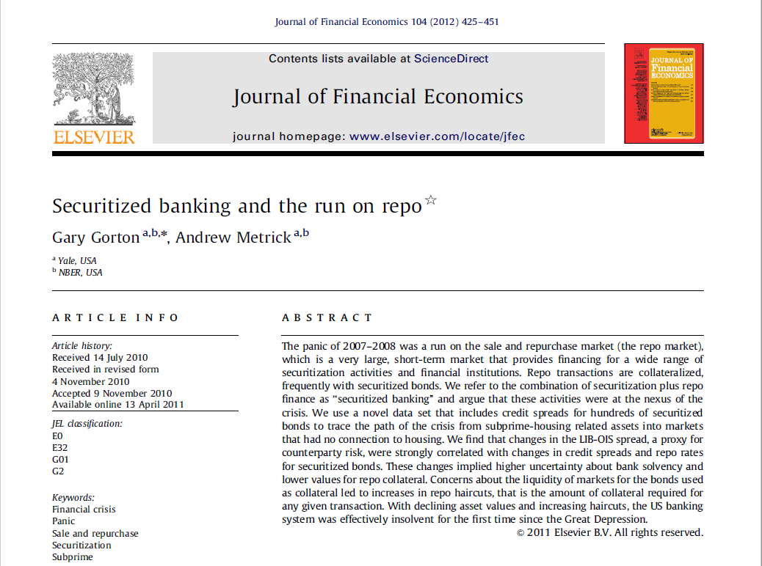
First Glance:

Slide 3
01
Introduction and Backgrounds
02
State Variables and Data
CONTENTS
03
Empirical Tests
04
Conclusion
05
My Opinion

Slide 4
01
Introduction and Backgrounds
1.1 Traditional-Banking & Securitized-Banking
1.2 Bank Run
1.3 The Subprime Mortgage Market
1.4 Securitization

Slide 5
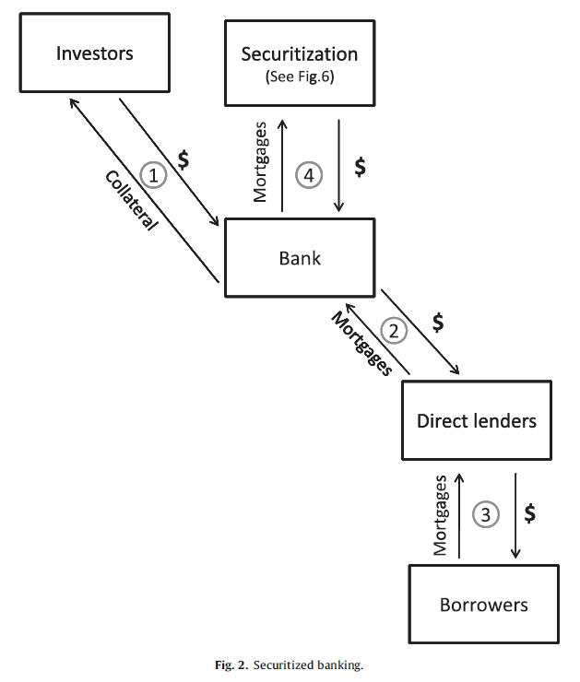
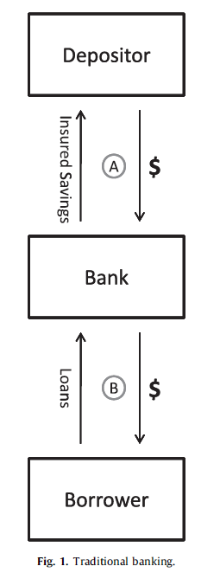
1.1 Traditional-Banking & Securitized-Banking
Traditional-Banking:
Driven by the withdraw of deposits
Step A: The depositors transfer money to the bank in return an account from which withdraws can be made.
Step B: The bank loans these funds to a borrower, who promises to repay in the future.
Securitized-Banking:
Driven by the withdraw of repurchase(repo)
Step 1: The investors transfer money to the bank in return of a collateral. (Repo agreement)
Step 2 and 3: The direct lenders, with a specialization of underwriting loans to be held for only a short time, underwrite the loans to borrowers and then sell the mortgages to the bank.
Step 4: The securitization itself made the transfer of mortgages from banks to outside investors possible. (Covered in Securitization section)

Slide 6
点击此处添加标题
点击此处添加标题
点击此处添加标题
What is Repo?
Step 1 in Securitized-Banking is an analogue to Step A from Traditional-Banking. In practice, to achieve similar protection in Step 1 of the Traditional-Banking, the deposit-collateral takes the form of a repo agreement:
The investor buys some asset (i.e. the collateral) with a market value of Z$ from the bank for X$, and the bank agrees to repurchase the same asset some time later (perhaps next day) for Y$.
If the bank defaults on the promise to repurchase the collateral ,then the investor has the right to terminate the agreement and keep or sell the collateral.
The percentage (Y-X)/X is the repo rate.
The difference between X and Z is the haircut.
For example, if an asset has a market value of $100 and banks sell it for 80$ with an repurchase price of $88:
The repo rate = (Y-X)/X = (88-80)/80 = 10%
The haircut = (Z-X)/Z = (100-80)/100 = 20%

Slide 7
1.1 Traditional-Banking & Securitized-Banking
Traditional-Banking | Securitized-Banking
Reserves | Haircuts
Minimum levels set by regulators Shortfalls can be borrowed from central bank | Minimum levels set by counterparties No borrowing from central bank
Deposit Insurance | Collateral
Guaranteed by the government | Cash, Treasury Securities, Loans, or Securitized bonds
Interest rates on Deposits | Repo Rates
Can be raised to attract deposits when reserves are low | Can be raised to attract counterparties when funds are low
Loans Held | Loans Securitized
Loans held on the balance sheet of the bank | Some securitized bonds can be kept on balance sheet and used as collateral

Slide 8
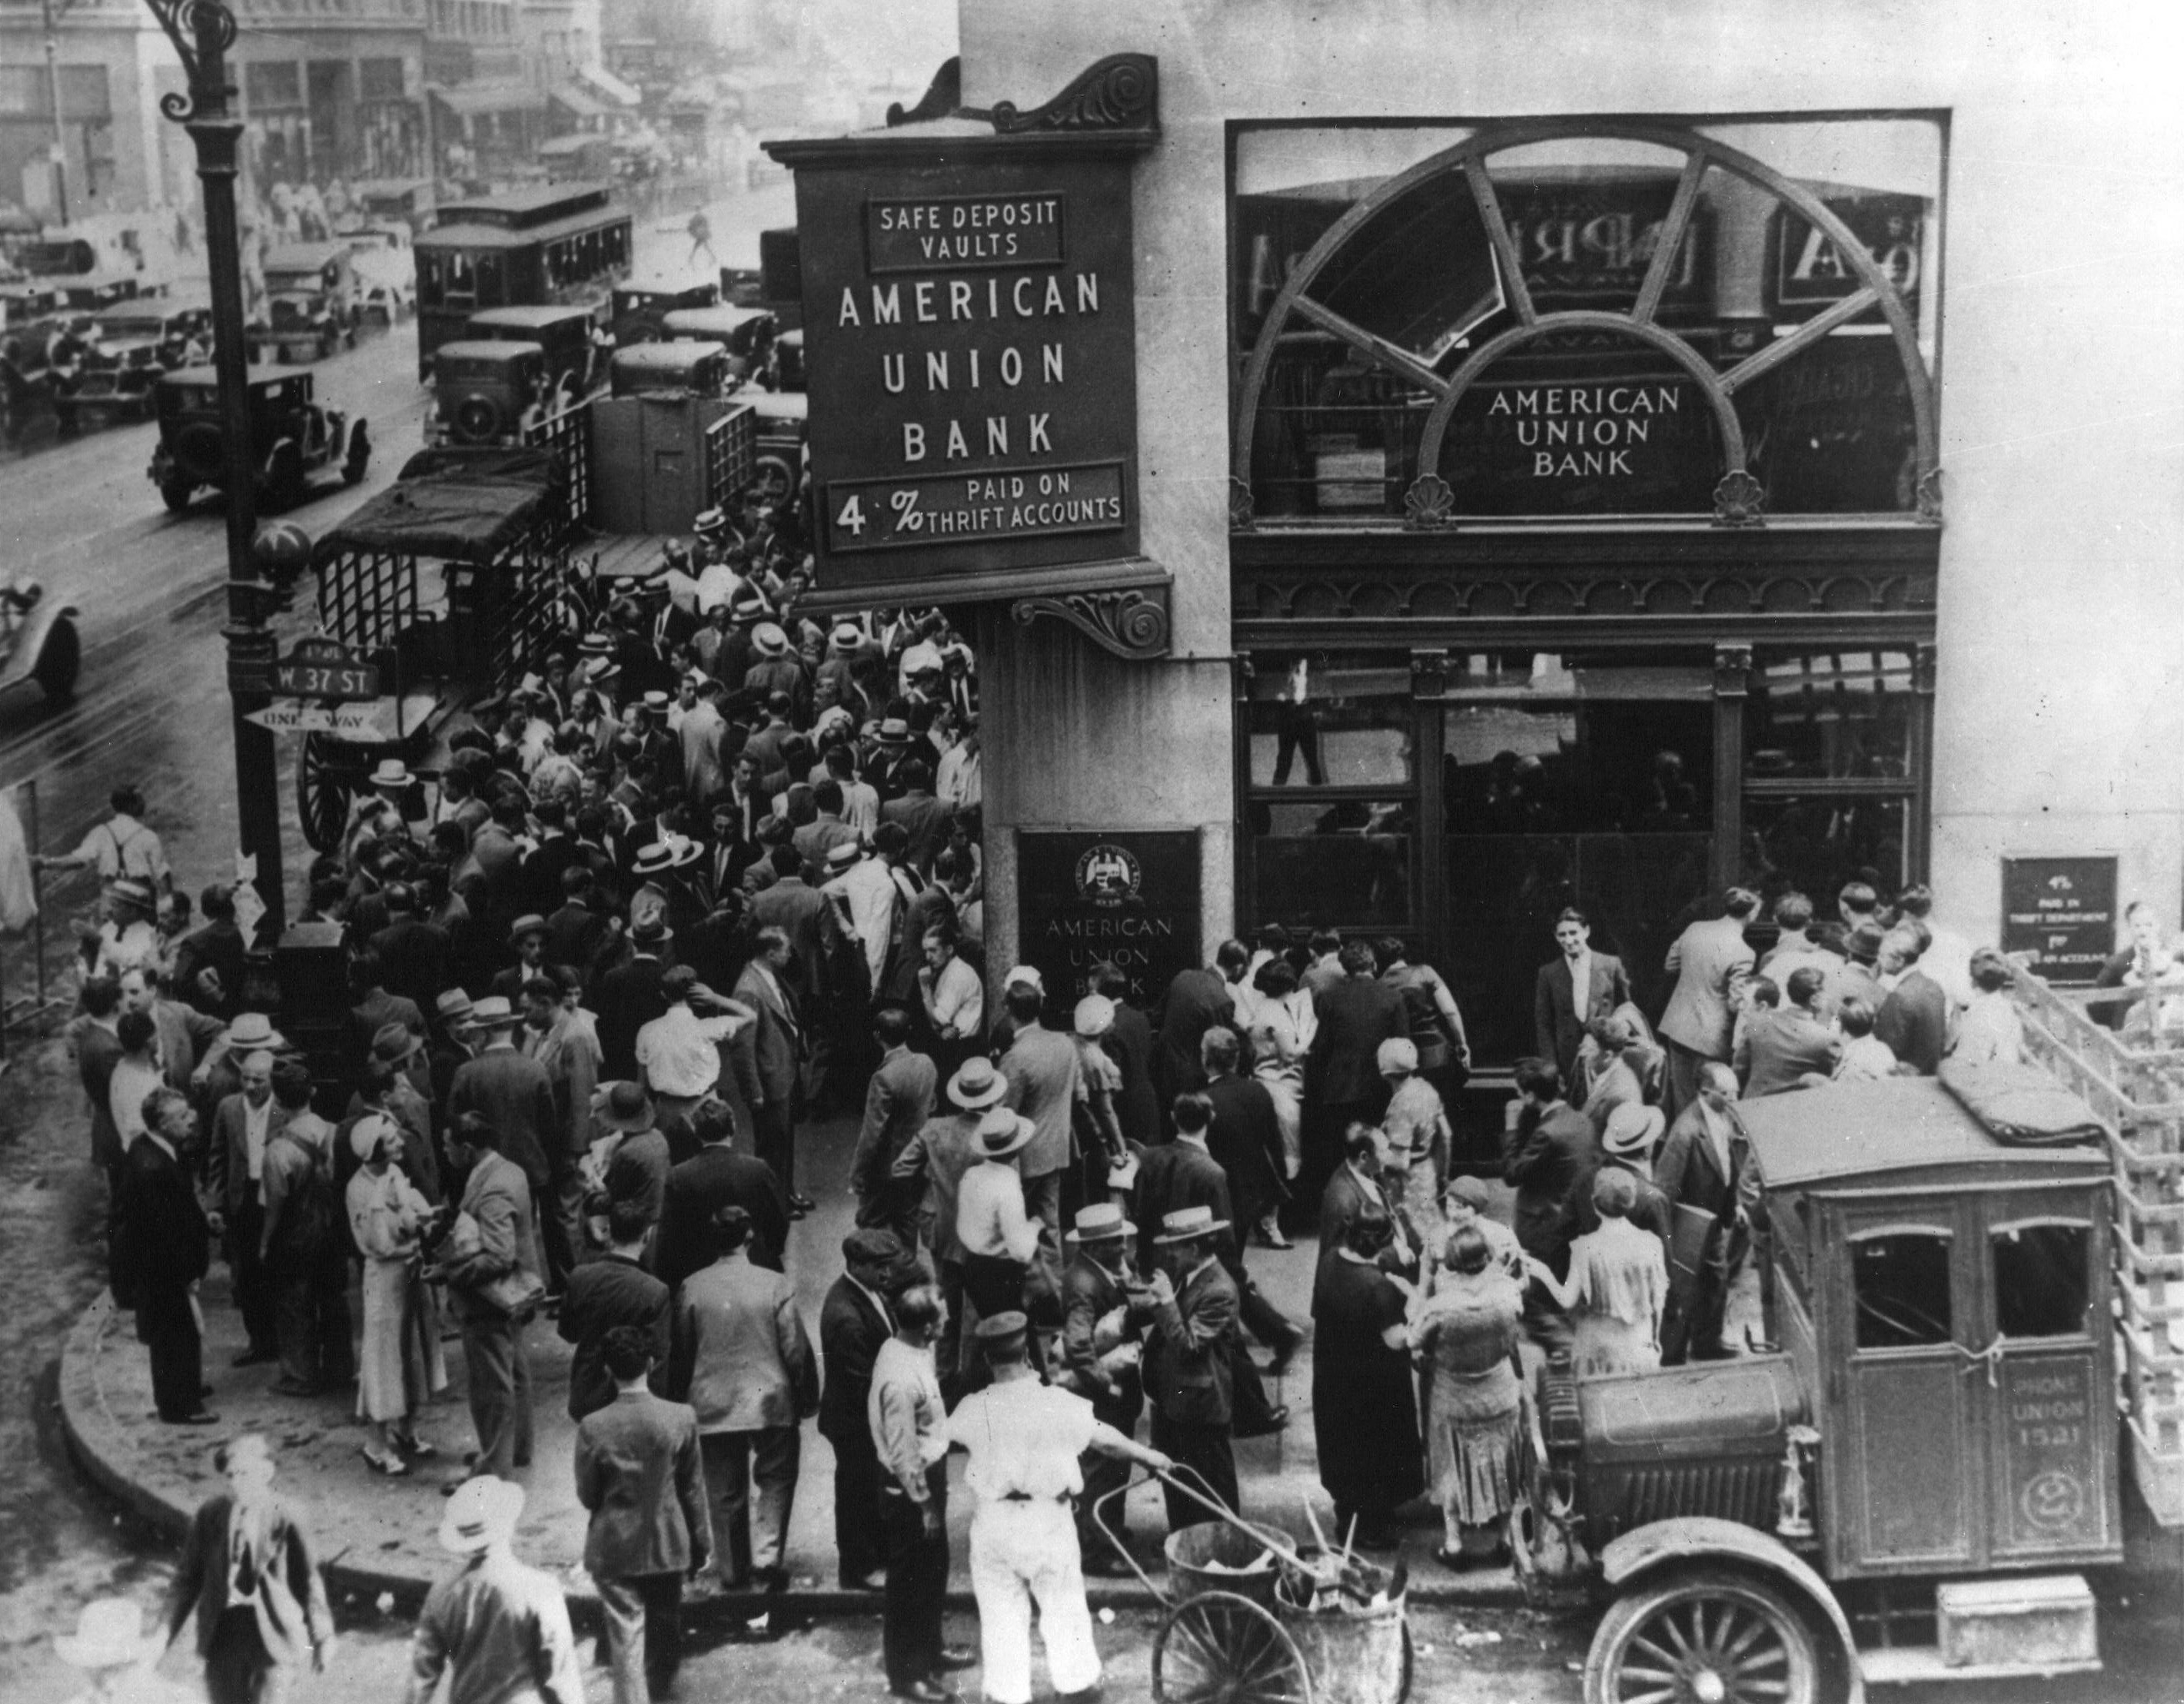
1.2 Bank Run
A bank run (also known as a run on the bank) occurs when a large number of people withdraw their money from a bank, because they believe the bank may cease to function in the near future.
A banking panic or bank panic is a financial crisis that occurs when many banks suffer runs at the same time, as people suddenly try to convert their threatened deposits into cash or try to get out of their domestic banking system altogether.
We would talk about Run on Repo later in this presentation.
American Union Bank, New York City. April 26, 1932

Slide 9
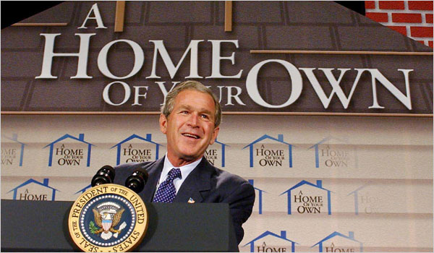
1.3 The Subprime Mortgage Market
George W. Bush in 2004:
“Not enough minorities own their own homes. One thing I’ve done is I’ve called on private sector mortgage banks and banks to be more aggressive about lending to first-time home buyers.”
The subprime mortgage market is a financial innovation, aimed at providing housing finance to people with spotty credit histories, a lack of income documentation, lack of money for a down payment.
The innovation was to structure the mortgage. This was accomplished with a fixed initial-period interest rate, but then at the reset date, having the rate rise significantly, essentially requiring the borrower to refinance the mortgage.
The innovation was a success. From 2001 to 2006, a total of about $2.5 trillion of subprime mortgage were originated. Almost half came in 2005 and 2006.

Slide 10
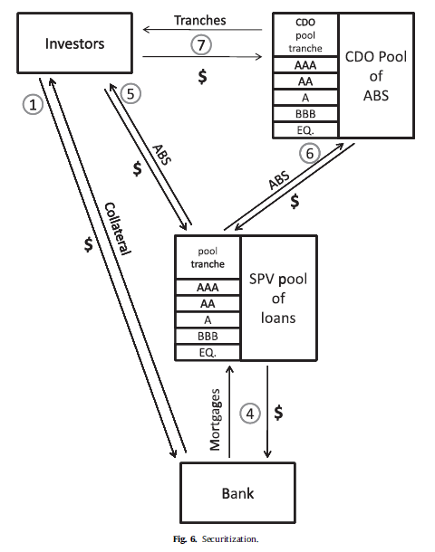
1.4 Securitization
A mortgage was sold in as part of a residential mortgage-backed security (RMBS), which involves pooling thousands of mortgages together, selling the pool to a special purpose vehicle (SPV) which finances their purchase by issuing investment-grade securities (i.e., bonds with ratings in the categories of AAA, AA, A, and BBB) with different seniority (called tranches) in the capital markets.
Securitization spawned a large number of new financial instruments and new usages for old instruments. Among these are the asset-backed security (ABS), credit default swap (CDS), collateralized debt obligation (CDO), and collateralized loan obligation (CLO).
Credit default swaps are derivative contracts under which one party insures another party against a loss due to default with reference to a specific corporate entity, asset-backed security, or index. For our purposes, the CDS spread, which is the fixed coupon paid by the party buying the protection, is an indication of the risk premium with regard to the specified corporate entity.
CDOs are securitizations of corporate bonds or asset-backed or mortgage-backed securities. CLOs are securitizations of loans to corporations.

Slide 11
02
State Variables and Data
2.1 Subprime Fundamentals and the ABX Indices
2.2 The Interbank Market and the LIB-OIS Spread
2.3 A Time Number Line for the Crisis
2.4 Data

Slide 12
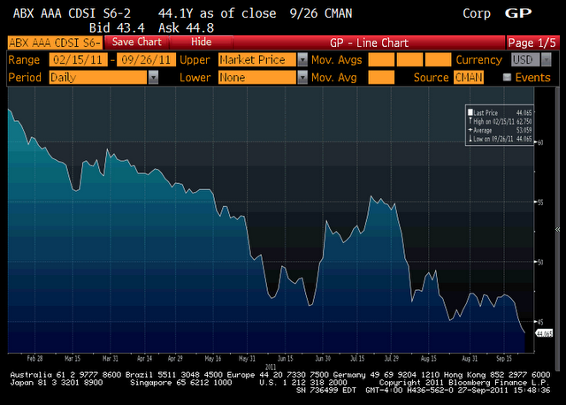
2.1 Subprime Fundamentals and the ABX Indices
ABX indices are proxies for fundamentals of the subprime market.
Specifically, dealer banks launched the ABX.HE (ABX) index in January 2006. The ABX index is a credit derivative that references 20 equally weighted subprime RMBS tranches. Sub-indices are linked to a basket of subprime bonds with specific ratings: AAA, AA, A, BBB and BBB-. Each sub-index references the 20 subprime RMBS bonds with the rating level of the sub-index.
This paper focus on the BBB ABX tranche of the first vintage of the ABX in 2006, which is representative of the riskier levels of subprime securitization. We refer to this tranche of the 2006-1 issue simply as ABX.

Slide 13
2.2 The Interbank Market and the LIB-OIS Spread
The proxy for the state of the interbank market and, in particular, the repo market is the spread between three-month LIBOR and the overnight index swap rate, which we call the LIB-OIS spread.
The overnight index swap (OIS) is a fixed-to-floating interest rate swap that ties the floating leg of the contract to a daily overnight reference rate, the feds funds rate.
If there is no credit risk and no transactions costs, then the interest rate on an interbank loan should equal the overnight index swap (LIB-OIS =0).

Slide 14
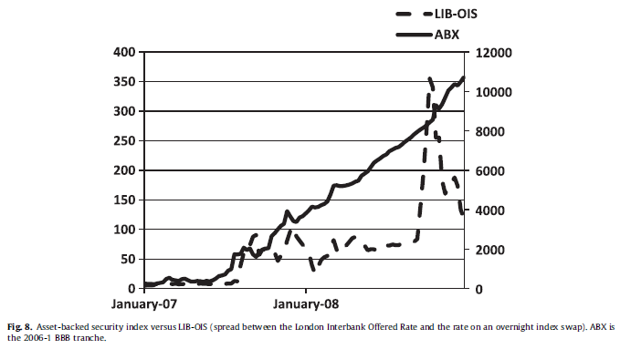
2.3 A Time Number Line for the Crisis
Divide the time between 2007-2008 to 4 parts:
First half of 2007, second half of 2007, first half of 2008 and second half of 2008.

Slide 15
2.4 Data: Summary
The data come from dealer banks, which observe market prices and convert these prices into spreads. The conversion of prices into spreads involves models of default timing and recovery amounts, and we are not privy to these models. However, one indication of the quality of the data is they were the source for marking-to-market the books of some major financial institutions
The data set contains 392 series of spreads on structured products, credit derivative indices, and a smaller set of single-company credit derivatives. In each case, the banks capture the on-the-run bond or tranche, which would be the spreads of interest to market participants. Fixed-rate bond spreads are spreads to Treasuries and floating-rate spreads are to LIBOR.
They summarized 5 Data Panels of spreads.

Slide 16
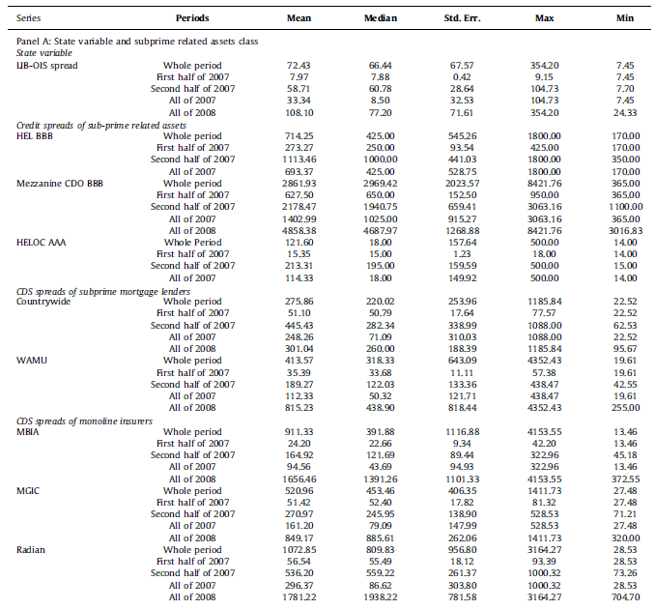
2.4 Data: Panel A
Panel A shows statistics for the state variable LIB-OIS and the credit spreads of three categories of subprime related assets.
From Panel A, it is clear that the subprime-related structured products and companies get hit in the second half of 2007.

Slide 17
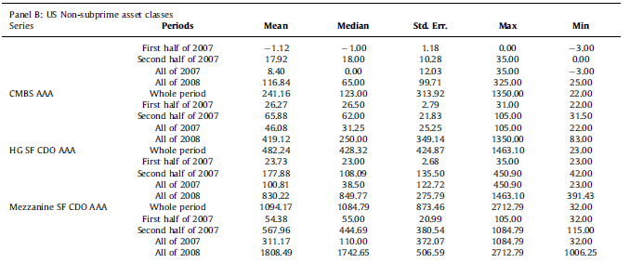
2.4 Data: Panel B
Panels B shows statistics for the credit spreads of US non-subprime asset classes.
For the six categories shown, there are increases in the spreads in the second half of 2007, but the large increases are in 2008.

Slide 18
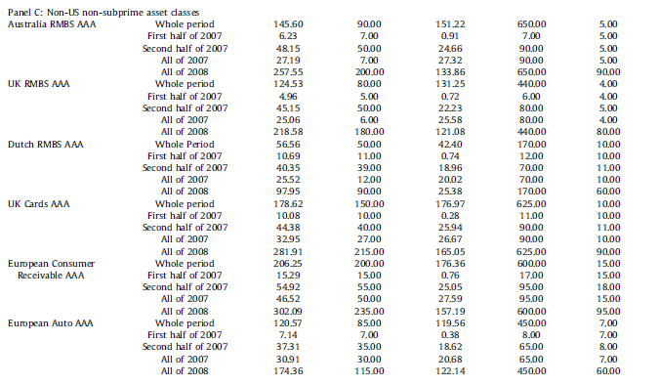
2.4 Data: Panel C
Panel C shows statistics for the credit spreads of non-US non-subprime asset classes
All categories are trading normally in the first half of 2007, and show increases in their spreads during the second half of 2007. But, the spreads significantly widen in 2008, as do the standard deviations of their spreads.

Slide 19
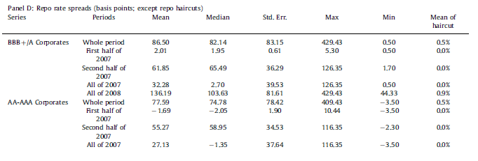
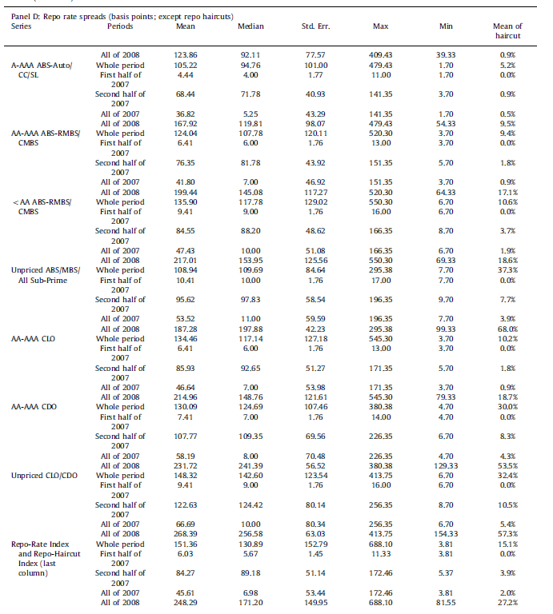
2.4 Data: Panel D
Panel D reports the statistics for the spreads between three-month repo rates and OIS with different collateral.
Overall, the patterns in repo are similar to those for the non-subprime-related asset classes; that is, the spreads rise in the second half of 2007 but become dramatically higher in 2008. The haircuts also become dramatically higher in 2008. The market disappeared for unpriced CDOs and CLOs, unpriced ABS and MBS, all subprime; and AA-AAA CDO.

Slide 20
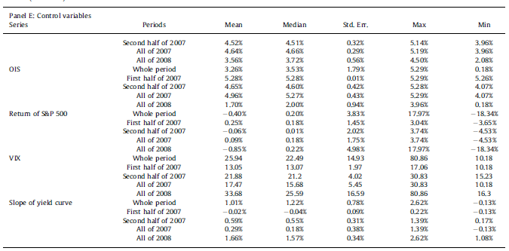
2.4 Data: Panel E
Panel E shows statistics for the five control variables

Slide 21
03
Empirical Tests
3.1 Methodology and Basic Tests
3.2 Credit Spreads for All Categories and Tranches
3.3 Repo Spreads
3.4 Repo Haircut

Slide 22
点击此处添加标题
顶部“开始”面板中可以对字体、字号、颜色、行距等进行修改。建议正文8-14号字，1.3倍字间距。
点击此处添加标题
顶部“开始”面板中可以对字体、字号、颜色、行距等进行修改。建议正文8-14号字，1.3倍字间距。
3.1 Methodology and Basic Tests
$$S_{i,t}=a_{0}+a_{1}t+b_{1}A{BX}_{t}+b_{2}LIB−OIS_{t}+b_{3}X_{t}+e_{i,t}$$
(1)
Spread on asset i at time t
Weekly time index
Vector of the last four observations of the ABX spread
Vector of the last four observation of the LIB-OIS spread
Vector of control variables
Take First Differences
$${∆S}_{i,t}=a_{1}+b_{1}∆A{BX}_{t}+b_{2}∆LIB−OIS_{t}+b_{3}∆X_{t}+e_{i,t}$$
(2)

Slide 23
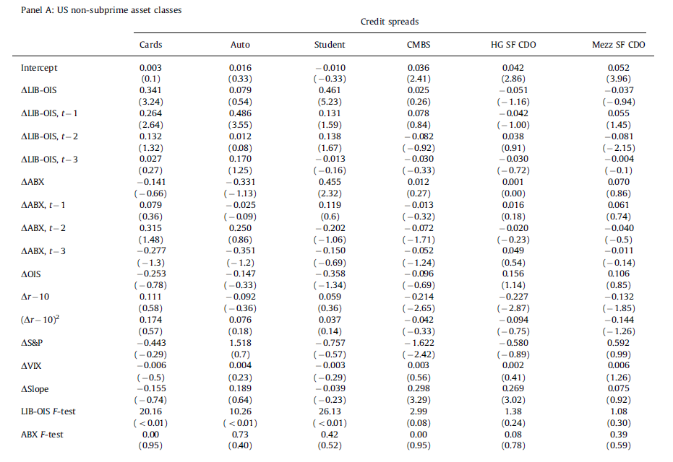
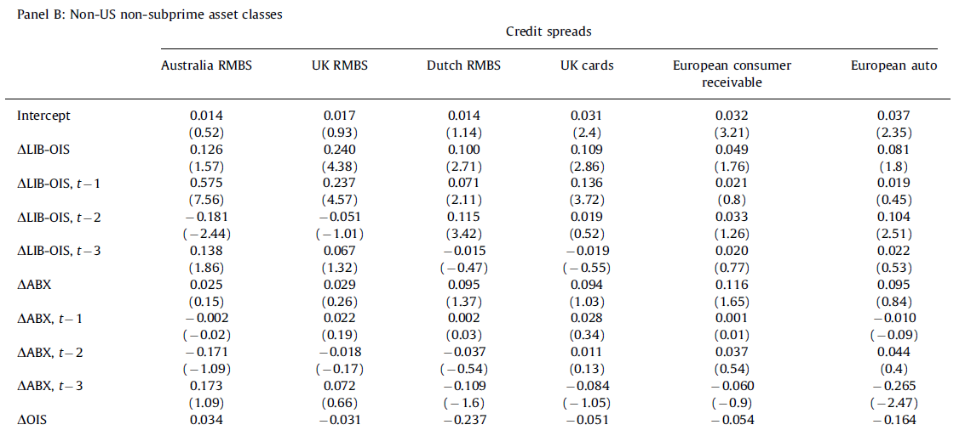
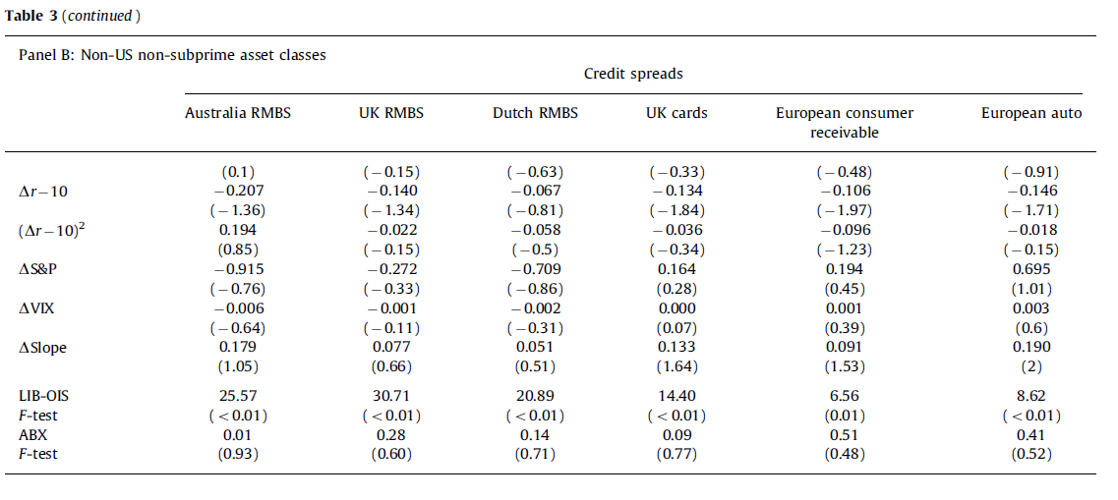
3.1 Methodology and Basic Tests
Null Hypothesis1: the coefficient on the ABX variables are jointly zero
Null Hypothesis2: the coefficient on the LIB-OIS variables are jointly zero
Credit spread for US non-subprime asset classes
Credit spread for non-US non-subprime asset classes

Slide 24
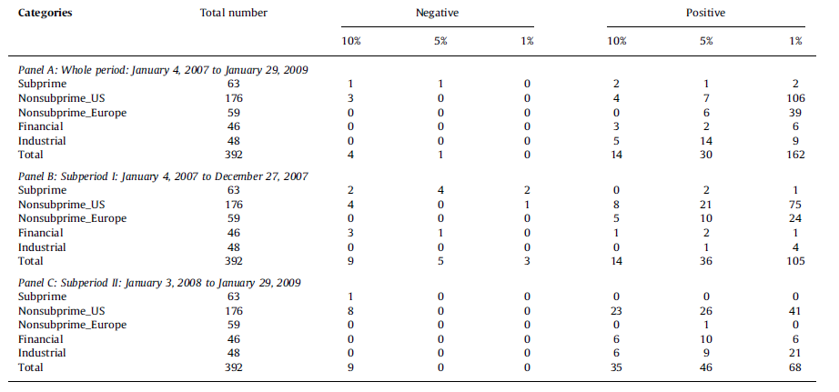
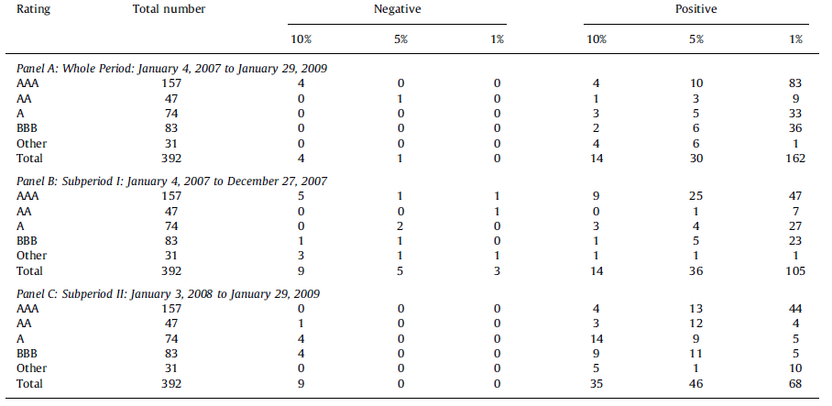
3.2 Credit Spreads for All Categories and Tranches
Null Hypothesis2: the coefficient on the LIB-OIS variables are jointly zero
Summary of F-test results for different asset categories and rating classes
Some highlights from first table are as follows. Subprime-related asset categories and the broad array of financial firms are not typically correlated to the LIB-OIS. But, for the overall period, Panel A, 66% of the US non-subprime asset classes are significantly positively correlated at the 10% confidence level. Similarly, 76% of the non-US non-subprime categories are positively correlated at the 10% level or lower. Note that most of this occurs in 2007 for the non-US structured products, but for the US non-subprime structured products it is split across 2007 and 2008. Also, note that for 2008, Panel C shows that 75% of the industrials are significantly, positively correlated to changes in LIB-OIS, indicating the real affects hitting the economy. In 2007, Panel B, there are no such real effects.
The second table presents the F-test results divided by rating category. Assets in all rating categories were eligible for repo, but AAA collateral was likely to be the most widely used. The table is suggestive in this regard, but not definitive. Looking at the whole period (Panel A), 62% of the AAA products were positively and significantly correlated with changes in LIB-OIS. This is about equally divided between the two subperiods. For AA, A, and BBB-rated bonds, the percentages that are significantly positive for the whole period are 28%, 55%, and 53%, respectively. For A and BBB, this is about equally divided between the two subperiods.

Slide 25
3.3 Repo Spreads
$${∆S}_{i,t}=a_{1}+b_{1}∆A{BX}_{t}+b_{2}∆LIB−OIS_{t}+b_{3}∆X_{t}+e_{i,t}$$
(2)
Add volatility of collateral price in the equation
(3)
$${∆R}_{j,t}=a_{1}+b_{1}∆A{BX}_{t}+b_{2}∆LIB−OIS_{t}+b_{3}∆X_{t}+b_{4}∆VOL_{j,t}+e_{i,t}$$
Spread of repo rates for some class j of collateral at time t
Vector of the last four observations of the ABX spread
Vector of the last four observation of the LIB-OIS spread
Vector of control variables
Vector of expected volatilities for certain class j of collateral

Slide 26
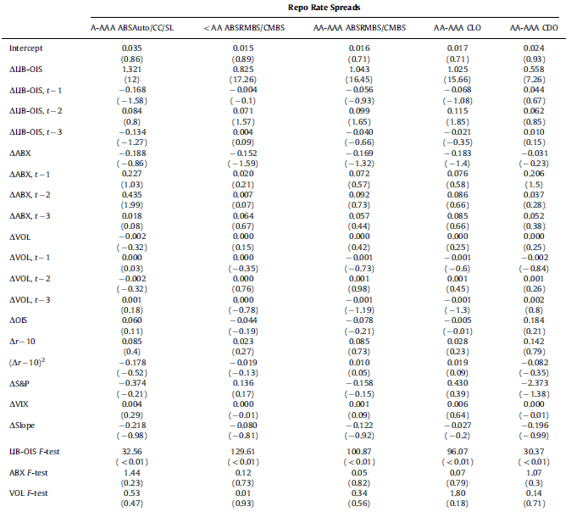
3.3 Repo Spreads
The null hypothesis of the LIB-OIS F-test is that the sum of all coefficients of △LIB-OIS and its lags is zero (jointly zero), and similar for ABX F-test and VOL F-test.
These tests show that the changes in repo spreads are significantly related to the change in LIB-OIS for all five categories, with almost all of the effect coming in the contemporaneous period.
Changes in repo spreads are not significantly related to changes in the ABX or VOL or to any of the other control variables. Thus, just as we found for credit spreads in our earlier analysis, the state variable for bank-counterparty risk is the only significant correlate with repo spreads.

Slide 27
3.4 Repo Haircuts
$${∆S}_{i,t}=a_{1}+b_{1}∆A{BX}_{t}+b_{2}∆LIB−OIS_{t}+b_{3}∆X_{t}+e_{i,t}$$
(2)
Add collateral pricing volatility in the equation
(4)
$${∆H}_{j,t}=a_{1}+b_{1}∆A{BX}_{t}+b_{2}∆LIB−OIS_{t}+b_{3}∆X_{t}+b_{4}∆VOL_{j,t}+e_{i,t}$$
Spread of haircuts for some class j of collateral at time t
Vector of the last four observations of the ABX spread
Vector of the last four observation of the LIB-OIS spread
Vector of control variables
Vector of expected volatilities for certain class j of collateral

Slide 28
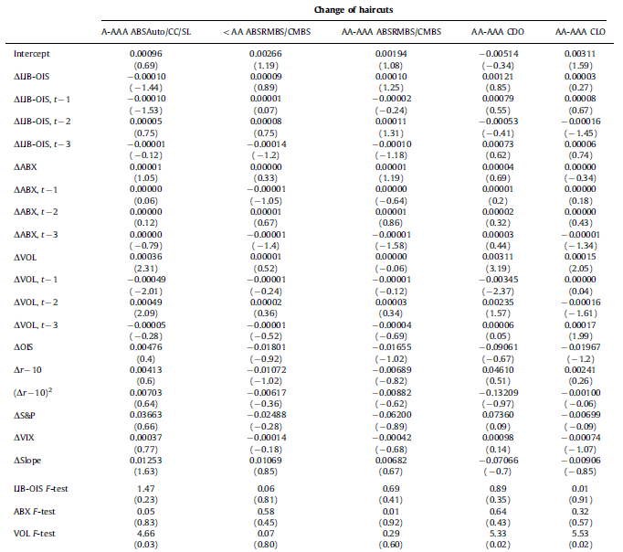
3.4 Repo Haircuts
The null hypothesis of the LIB-OIS F-test is that the sum of all coefficients of △LIB-OIS and its lags is zero (jointly zero), and similar for ABX F-test and VOL F-test.
As we have found in earlier tests, the ABX and the control variables are not significant. In contrast to previous regressions, the change in the LIB-OIS is also not significant. The only variable with any explanatory power is the proxy for expected volatility, which is significant for three of the five classes of collateral.

Slide 29
Empirical Test Summary
The key finding here is that both repo spreads and repo haircuts rose during the crisis, with these increases correlated either to concerns about counterparty risk (for spreads), or to uncertainty about collateral values (for haircuts).
While these results are somewhat different for spreads and haircuts, we suspect that this system is jointly determined and that a disruption in the interbank market and increases in uncertainty about collateral are both necessary conditions for a run on repo.
It seems unlikely that nature provides an example with rising VOL but no change in LIB-OIS. Instead, all of these things happened at the same time, and it is not possible to disentangle the exact causes.
They also proved that for the early part of the crisis, it seems that the counterparty-risk component of LIB-OIS is much more important for our results than is the market-liquidity component.

Slide 30
04
Conclusion

Slide 31
4. Conclusion
01
The run on repo lead the problems in subprime market to a systemic event:
How did problems in the subprime mortgages cause a systemic event? Our answer is that there was a run in the repo market. The location and size of subprime risks held by counterparties in the repo market were not known and led to fear that liquidity would dry up for collateral, in particular non-subprime related collateral. Public shocks causing expected future spread volatility led to increases in the repo haircuts, which is tantamount to massive withdrawals from the banking system.

Slide 32
4. Conclusion
02
How did the run on repo happen?
The banking system has changed, with securitized banking playing an increasing role alongside traditional banking. One large area of securitized banking, the securitization of subprime home mortgages, began to weaken in early 2007 and continued to decline throughout 2007 and 2008. But, the weakening of subprime per se was not the shock that caused systemic problems. The first systemic event occurs in August 2007, with a shock to the repo market that we demonstrate using the LIB-OIS, the spread between the LIBOR and the OIS, as a proxy. The reason that this shock occurred in August 2007, as opposed to any other month of 2007, is perhaps unknowable. We hypothesize that the market slowly became aware of the risks associated with the subprime market, which then led to doubts about repo collateral and bank solvency. At some point (August 2007 in this telling) a critical mass of such fears led to the first run on repo, with lenders no longer willing to provide short-term finance at historical spreads and haircuts.

Slide 33
4. Conclusion
03
How did the run on repo become bigger?
After August 2007, the securitized-banking model was under pressure, with small equity bases stretched by increasing haircuts on high-grade collateral. We see evidence of this pressure in the co-movement of spreads on a wide variety of AAA and AA credits. This pressure contributed to the forced rescue of Bear Stearns in March 2008 and the failure of Lehman Brothers in September 2008. The second systemic event and run on repo occurred with the failure of Lehman. In this second event, we see parallels to 19th century banking crises, with a famine of liquidity leading to significant premia on even the safest of assets.

Slide 34
My Opinion

Slide 35
THANK YOU!

